Slide 1

THERMO ELECTRIC REFRIGERATION
Prajjwal Chittori 2k18/co/249

Slide 2
Contents
Abstract
Introduction to thermoelectric refrigeration
Concept of project work
Methods of refrigeration
Principle of working
Description of parts
Specification of refrigerator, power calculations
Performance of thermo electric refrigerator
Comparison with normal refrigerator
Advantages and applications
Conclusion
Bibliography

Slide 3
Abstract
The impact of on-going progress in Science and Technology has created a variety of systems that can be used in producing of refrigeration effect with the use of Thermoelectric Module and Photovoltaic Module for generation of energy which we further use for cooling and heating effect. The most important utilization of this portable cooler is for the preservation of insulin in extreme conditions A Thermoelectric module (TEM) is used instead of compressor so that it become portable, as it is based on the principles of Peltier effect. The use of Peltier effect is to create a heating side and a cooling side and also to maintain effectiveness
Thermoelectric cooler (TEC) is a solid state heat pump which uses the components are available commercially. The thermoelectric refrigerator does not produce chlorofluorocarbon (CFC). It is pollutant free-contains no liquids or gases, portable, compact, creates no vibration or noise because of the difference in the mechanics of the system. It is a prototype and its semiconductor materials, by Peltier effect, to provide instantaneous cooling or heating. It has the advantage of having no moving parts and thus maintenance free.

Slide 4
Introduction to Thermo Electric Refrigeration
When aclosed circuit of two dissimilar metals and two junctions is formed, a current will flow between the junctions or the circuit. This phenomenon is known as the Seebeck effect. Jean.C.Peltier, a French watchmaker and an amateur scientist discovered a reverse effect of the Seebeck.He discovered that using joined dissimilar metals heat pump can be made.
He foundthat by the use of two dissimilar
metals

Slide 5
Concept of project work
Thermoelectric cooling uses the Pettier
effect to create a heat flux between the junctions of two different types of materials. A Peltier cooler, heater or thermoelectric heat pump is a solid-state active heat pump which transfers heat from one side of the device to the other, with consumption of electrical energy, depending on the direction of the current.
Such an instrument is also called a Peltier device, Peltier heat pump, solid state refrigerator, or thermoelectric cooler (TEC). It can be used either for heating or for cooling, although in practice the main application is cooling. It can also be used as a temperature controller that either heats or cools.

Slide 6
Methods of refrigeration
Cyclic refrigeration Vapor-Compression cycle Vapor- absorption cycle
Non-cyclic refrigeration Thermoelectric refrigeration
Magnetic refrigeration

Slide 7
Thermo electric refrigeration
Thermoelectric cooling uses the Peltier effect to create a heat flux between the junction of two different types of materials. This effect is commonly used in camping and portable coolers and for cooling electronic components and small instruments.
The two dissimilar conductors are doped in a ceramic wafer this ceramic component is pielter device for which produces the cooling effect which we use it as component for refrigeration.

Slide 8
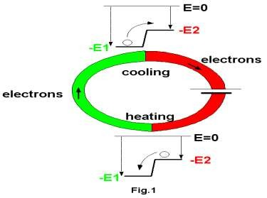
Principle of working
PELTIER EFFECT
The thermoelectric refrigerator works on the PELTIER effect that The Peltier–Seebeck effect, or thermoelectric effect, is the direct conversion of thermal differentials to electric voltage and vice versa. Related effects are the Thomson effect and Joule heating. The Peltier– Seebeck and Thomson effects are reversible (in fact, the Peltier and Seebeck effects are reversals of one another); Joule heating cannot be reversible under the laws of thermodynamics.
•
•

Slide 9
Working animation of module

Slide 10
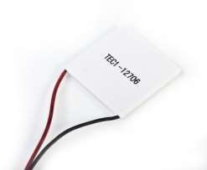
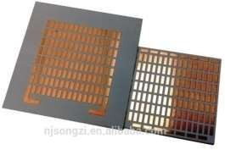
Description of parts
Thermo electric module
Thermoelectric modules (Peltier
modules) are solid-state heat
pumps that operate on the Peltier effect. Heat pump is a
thermodynamic system, which transfers heat from low
temperature
body
body and gives out the same to high temperature

Slide 11
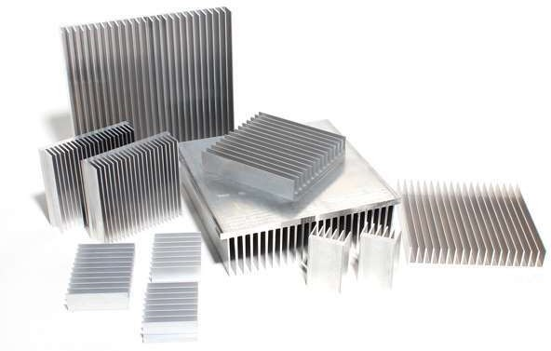
Heat sink
A heat sink is a passive heat exchanger that transfers the heat generated by an electronic or a mechanical device into a coolant fluid in motion. Then-transferred heat leaves the device with the fluid in motion, therefore allowing the regulation of the device temperature at physically feasible levels.

Slide 12
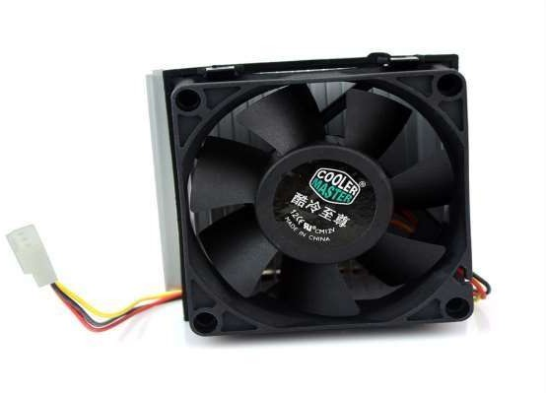
Heat sink fan
Sometimes the heat sink itself becomes hot during the heat transfer to overcome this problem a device called heat sink fan is used for the removal of induced heat in the fins of the heat sink..So these fans are attached over the fins of the heat sink and it cools down the heat produced in the heat sink .

Slide 13
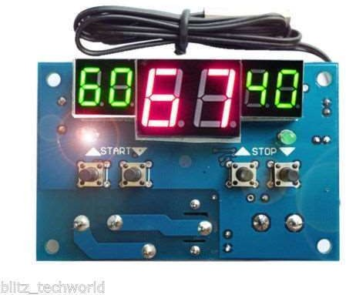
Temperature indicator
The temperature indicator is device that is used to know about the temperature inside the chamber of refrigerator. It has a probe which is inserted inside the chamber of refrigerator and the probe senses the temperature inside and gives the temperature data to the output display.

Slide 14
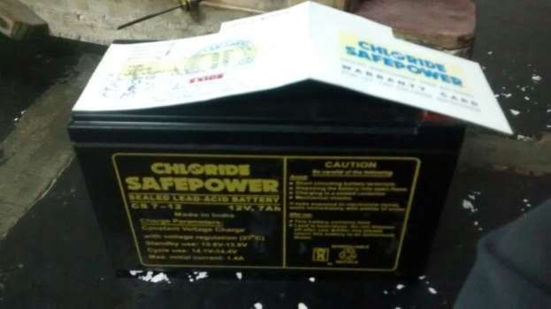
Battery
Battery is used send current to the refrigerator it is of 6 volts and 7.5 amperes and is of rechargeable type.

Slide 15
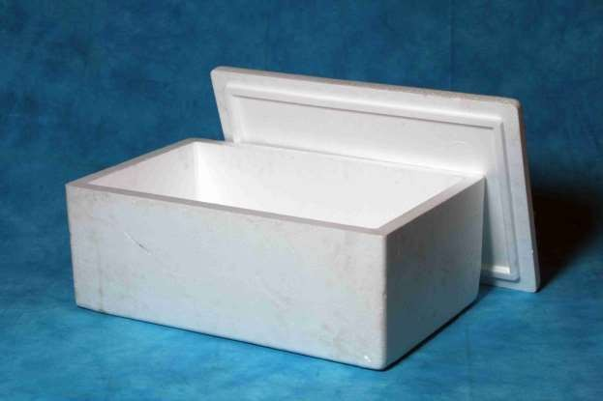
Thermal casing
Thermal casing is made of thermo coal and is used for keeping cool inside and to store the storage beverages and food stuffing’s in the refrigerator.

Slide 16
Specifications of refrigerator
Module
Model number: TEC1-12706
Voltage : 12V
U max (V) : 15.4V
Imax (A) : 6A
Q Max (W) : 92W
Internal resistance: 1.98 Ohm +/- 10%
Dimensions : 40mm x 40mm x 3.6mm
Power Cord : 350mm
HS Code: 854150
Type: Cooling Cells
Usage: Refrigerator/Warmer
Dimension: 40*40*3.8mm

Slide 17
Power calculations
Electrical power is used to run the refrigerator and the details are
mentioned below
Source: 12volts DC battery
Module: 12 volts
Fans: 7 amps
Temperature indicator: 12 volts
No of Phases: 1 phase
Minimum power required is 12 volts and a maximum of 56 volts and it is supplied by the dc source (battery)
Electrical Data
Power source: 12volts dc battery
Ratted supply: 12volts 7.5 amps
Fan speed
Minimum speed: 1000RPM
Moderate speed: 2000RPM
Maximum speed: 3000RPM
•

Slide 18
Comparison with normal refrigerator
S no | Criteria | Thermo electric refrigerator | Normal refrigerator
1 | Cooling method | Non Cyclic refrigeration | Vapour compression cycle
2 | Components | Thermo electric module | Condenser, Compressor, Evaporators
3 | Main advantage | Portable | Not portable
4 | Power Consumption | 12-56 volts | 220volts
5 | COP | Comparatively less | High COP
6 | Uses | Melting of chocolates Insulin preservation etc | Ice Cold water etc.

Slide 19
Advantages
These are environment friendly. (No C.F.C)
These are light in weight.
Give fast temperature response.
It is portable, small in size.
Can be used during travelling.
Can be used at military base.
Have no vibrations.
Creates no noise.

Slide 20
Applications
For preservation of insulin and other drugs.
For preservation of food stuffs.
For cold water.
For beverages

Slide 21
Conclusion
The coefficient of performance of this refrigerator is much smaller than that of a conventional compressor-type refrigerator when the required cooling capacity is high, whereas the coefficient of performance of the conventional unit falls off rapidly as the cooling capacity is decreased and that of thermo electric unit remains constant. Thus a conventional refrigerator is preferred when the required cooling capacity is high and a thermoelectric refrigerator should be chosen when a low cooling capacity is needed. The cold side of the thermoelectric module was utilized for refrigeration purposes whereas the rejected heat from the hot side of the module was eliminated using heat sinks and fans
As the cooling units are of small size, silent, contains no liquids or gases, have no moving parts and have a long life. It is very simple to control the rate of cooling by adjustment of the current, the response to changes in the supply is very rapid, while reversal of the direction of the current transforms a cooling unit into a heater with a coefficient of performance in excess of unity i.e. a heat pump for oven. In this work, a portable compressor less refrigerator unit was fabricated and tested for the cooling purpose
This is completely eco-friendly project Multipurpose and Portable

Slide 22
Bibliography
•
- S.Domkundwar
-P.L.Balleny
-ROY.J.Dassat
-E.Vijay Kumar
-P.N.Ananta
REFRIGERATION AND AIRCONDITIONING
REFRIGERATION AND AIRCONDITIONING
PRINCIPLES OF REFRIGERATION
REFRIGERATION AND AIRCONDITIONING
BASIC REFRIGERATION AND AIRCONDITIONING
REFRIGERATION AND AIRCONDITIONING
-B.L.Theraja
REFRIGERATION AND AIRCONDITIONING
- M.Zakira Baig
REFRIGERATION AND AIRCONDITIONING
-C.P.Arora

Slide 23


